Slide 1

Micro Tanker V5
Kimanthi

Slide 2
MT business case
The MT is the workhorse of the last mile distribution of TA that keeps the KP’s perpetually wet.
The MT capacity (800 litres) allows the MT to serve several KP’s in milk runs before returning to base.
MT is a proposed two man operation with a driver and “side kick” who assists the driver in the repetitive manual tasks of un-rolling and connecting hoses as well as bonding cables sometimes above head height. The second man also performs the task of spill and fire watch.

Slide 3
MT V5 Technical Requirements
Improvement of safety, Standards setting
The MT V5 will incorporate a stainless steel tank, total Volume 950 Litres and a working capacity of 800Litres.
Removing the IBC tank to afford the MT V5 ability to capacity to withstand a two hour fire without loss of TA containment.
Provide MT V5 strength and rigidity in case of roll overs or a crush, we do not want to lose TA containment.
Bring MT V5 to standards comparable to those of Oil marketing Companies (OMC’s) to allow seamless integration in case the Fuels Business moves to OMC fuels logistics partners.
Provide brackets to hold two fire extinguishers at all times.

Slide 4
MT Vehicle checklist before refill
Valid road license
Valid insurance certificate
Tires must be checked to ensure adequate tread depth
Vehicle must be able to self start
All lights and turn signals must be operational
Spare tire must be checked and be seen to be in good condition
Drivers license must be checked and seen to be valid and allowing the driver to drive that class of vehicle.
Drivers name must correspond to the name assigned by DM to that micro tanker
The registration details of the MT are checked to ensure it is the correct vehicle assigned to the driver

Slide 5
MT V5 Refill Procedures
Park the MT in the correct position for MT refill, close to the depot pump
Set the hand (parking) breaks and switch off the engine
Set the chock blocks to ensure the vehicle will not move during refilling
Remove fire extinguishers from their baskets and set them one in front and one at the back of the MT with the safety pins removed
Driver and assistant to ensure they wear appropriate PPE including eye protection, gloves and high visibility vests
Open system box, switch on the MT tanker system and select refill to open refill valves

Slide 6
MT V5 Refill Procedures
Connect bonding (grounding) cable between MT and depot
Connect fuel refill and vapour return line from the depot to the MT coupling.
Open the manual valves on the depot lines.
Set the volume to be filled into the MT on the depot dispenser and start the refill process
After refill process is complete, end refill task on the tanker app. This will close the MT refill valves. Shut the manual valves on the refill lines before the MT couplings.

Slide 7
MT V5 Refill Procedures
Disconnect the refill and vapour return lines and store them away at the depot dispenser
Switch off the MT Tanker system
Disconnect the bonding cable from the MT.
Replace fire extinguisher safety pins, stow them back in their baskets and secure them.
Perform a walk around check of the MT to make sure that everything is secured in place and all MT-depot connections are removed.
Remove wheel chocks and stow them away.
Drive away to refill KP’s

Slide 8
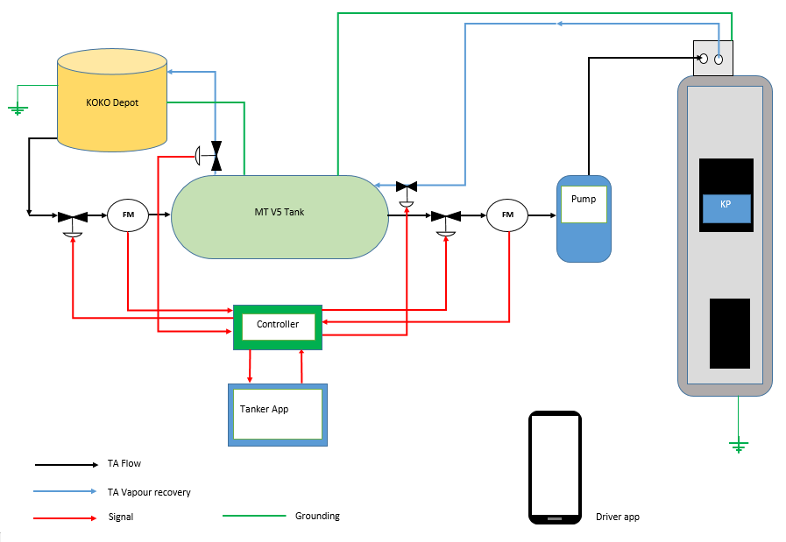
Schematics of MT V5

Slide 9
Requirements
Tank design
Normal payload (tank + 800 litres of TA) of 741 kg, enough for an ACE
Extra capacity of 150 litres (118 kg) allows for more product when route terrain allows for it.
Single tank with an internal baffle (partition) to reduce liquid sloshing so as to improving driving safety.
Tank has a bottom outlet valve and a double inlet at the top for product fill and vapour recovery inlet.
Tank shell is 2.5 mm of Stainless steel.
Tank manhole 500 mm.
Well designed bolt on points to the flat bed of the ACE to provide secure fastening.

Slide 10
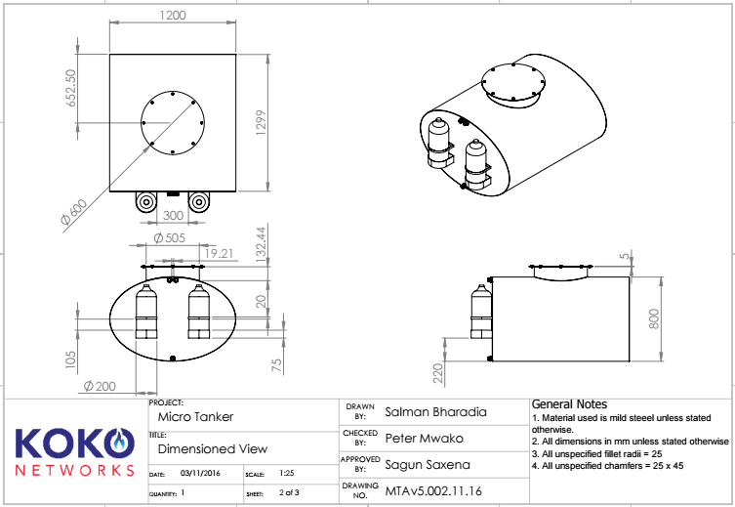
MT V5 Tank drawing

Slide 11
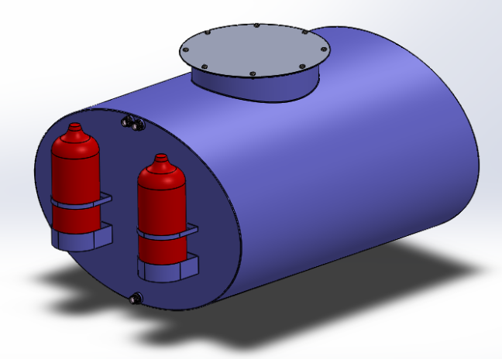
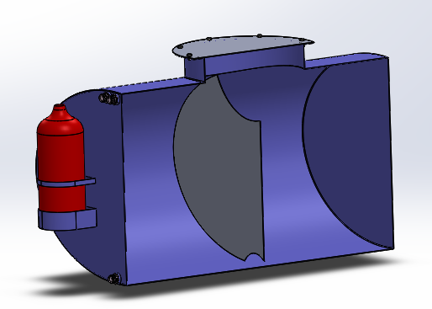
MT V5 Tank 3D representation
3D tank rendering
Tank Section showing internal buffle

Slide 12
Requirements
MT System design
Comprised of available commercially ethanol dispensers with dispense volume pre sets (sourced from Fine Meters China). This allows us to incorporate systems with proven HSE aspects into our build.
KOKO Networks system (Sensors and controls and SW) sits between the commercial dispenser and the MT V5 tank as well as between the MT V5 inlet flange and the depot and provides KOKO and KOKO systems complete visibility and control of inventory movement as well as tracking into and out of the MT V5.

Slide 13
MT V5 Budgets

Slide 14
Drivers app
Drivers app performs various functions:
Shows the driver the KP refill schedule
Helps the driver to navigate to the scheduled KP
Unlocks the KP refill box by use of a Bluetooth key
Shows KP refill progress

Slide 15
MT V5 Timelines

Slide 16
KP Refill Procedures
After arriving at the agent location, park the MT as indicated in the image on the drivers app taking care not to .
Set the hand (parking) breaks and switch off the engine.
Set the chock blocks to ensure the vehicle will not move during KP refilling.
Remove fire extinguishers from their baskets and set them one in front and one at the back of the MT with the safety pins removed
Driver and assistant to ensure they wear appropriate PPE including eye protection, gloves and high visibility vests

Slide 17
KP Refill Procedures
Open system box, switch on the MT tanker system and select KP refill to open MT’s KP refill valves.
On the driver’s app, select next so that the drivers app generates a Bluetooth key to open KP refill box.
Open the refill box.
Unroll the hoses from the MT hose reel and connect the bonding cable from the MT to the refill box, then connect the hoses to their respective couplings in the refill box.
Open the manual valves on the hoses.
Set the volume to be refilled into the KP on the MT app and start the refill.

Slide 18
KP Refill Procedures
The refill process can be monitored from the driver app.
After refill process is completed, complete the refill process on the driver app.
Also, end the refill task on the tanker app. This will close the MT’s KP refill valves. Shut the manual valves on the refill lines before the KP couplings.
Disconnect the refill and vapour return lines, disconnect the bonding cable from the MT and store them away at the MT hose reels
Switch off the MT Tanker app.

Slide 19
Replace fire extinguisher safety pins, stow them back in their baskets and secure them.
1
Perform a walk around check of the MT to make sure that everything is secured in place and all MT-KP connections are removed.
2
Remove wheel chocks and stow them away.
3
Check the driver app to see the next scheduled KP for refill. Click next to navigate to the next KP.
4
Drive away to refill KP’s
5
KP Refill Procedures

